Slide 1
eduGAIN OpenID Federation Pilot
Niels van Dijk (SURF) & Davide Vaghetti (GARR)
EIC2026, Berlin,May 2026
Public (PU)

Slide 2

“eduGAIN interfederation service connects identity federations around the world, simplifying access to content, services and resources for the global research and education community”

Slide 3
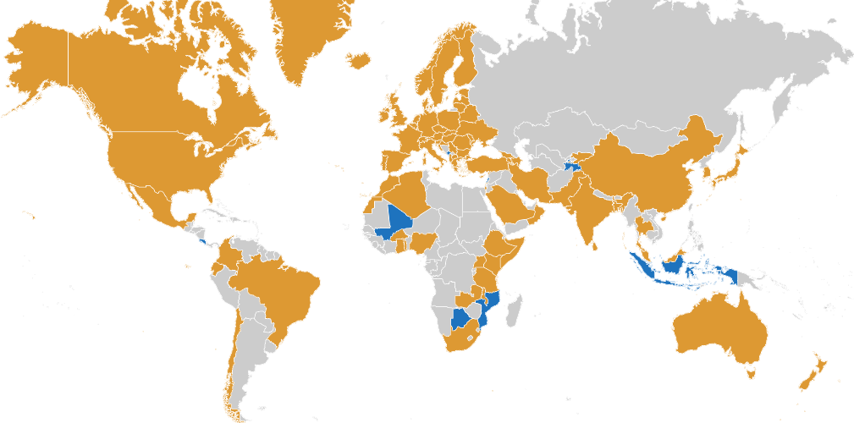
eduGAIN Global Coverage
84 Federations
> 10k Entities
6333 Identity Providers
3998 Service Providers
https://edugain.org & https://technical.edugain.org/

Slide 4
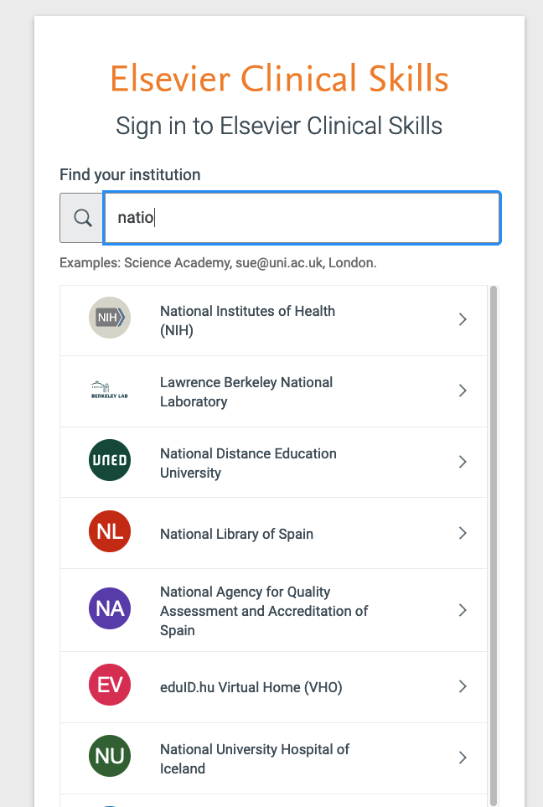
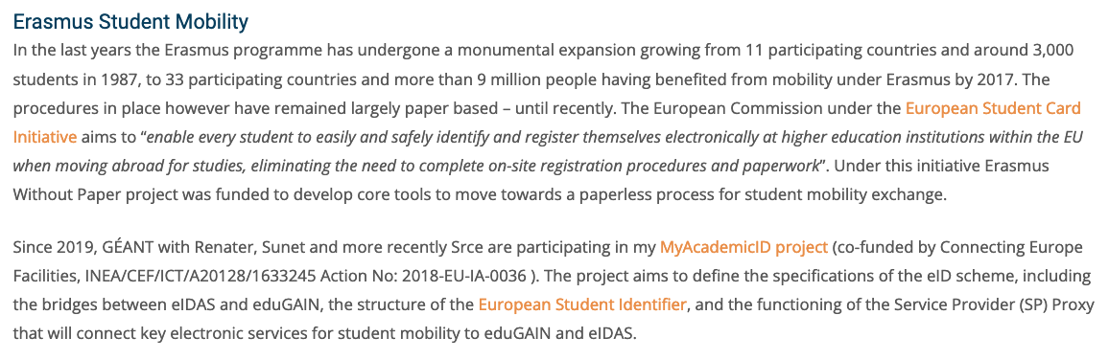
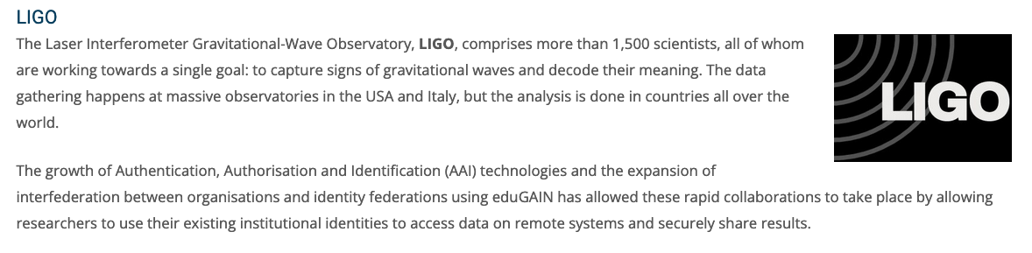
What do we use it for?
Notes:
3 high level scenarios:
1) Institutional access to (international) resources
2) Global scientific collaborations like CERN, LIGO. with very expensive resources (LUMI supercomputer) and sensitive data like is used in the healthcare collaborations
3) University alliances and international student mobility

Slide 5





eduGAIN and OpenID Federation: why
Research and Education needs a global trust infrastructure which can span country, sector (and protocol) borders
R&E Federations and eduGAIN are based on SAML 2.0, which is a legacy protocol.
The OpenID Federation specification is a protocol independent way of describing trust, already supporting OAuth 2.0, OpenID Connect 1.0 and Wallets
OpenID Federation is both real time and dynamic, which is essential for scalable and secure establishment of trust
Notes:
Talk about use of SAML federation metadata and its challanges

Slide 6
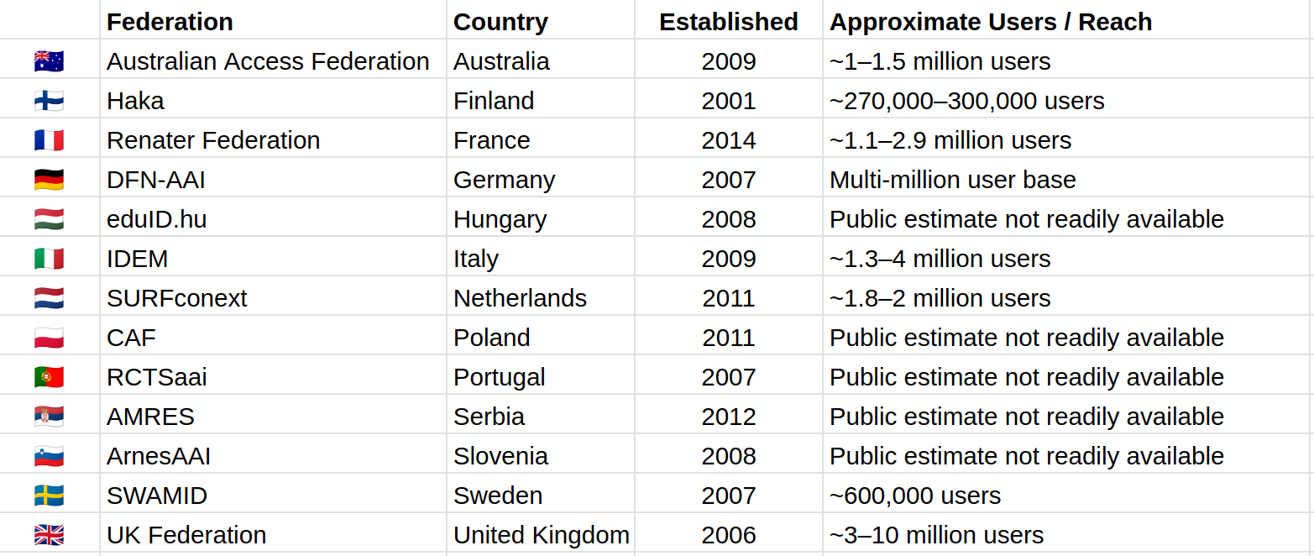
eduGAIN OpenID Federation Pilot: Participants
Notes:
Many countries also outside of EU
Existing infra up to 20 years of experience
Covering many of the larger EU countries and many millions of users

Slide 7
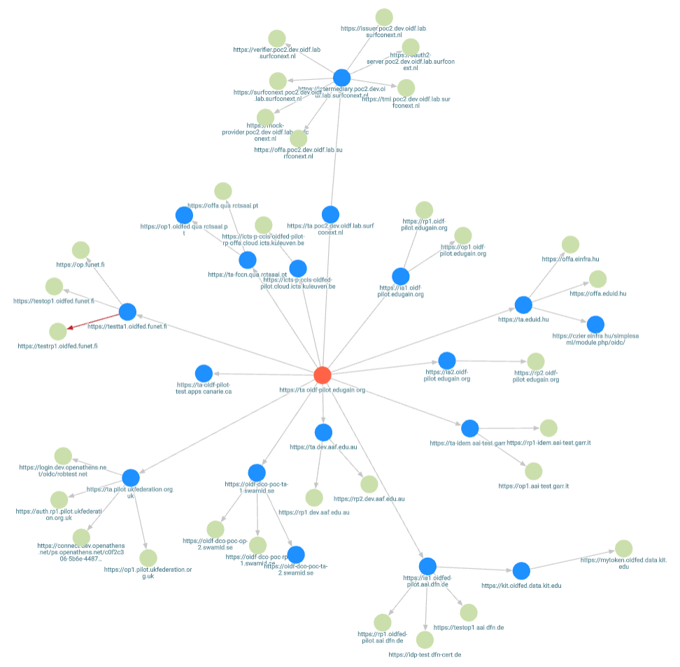
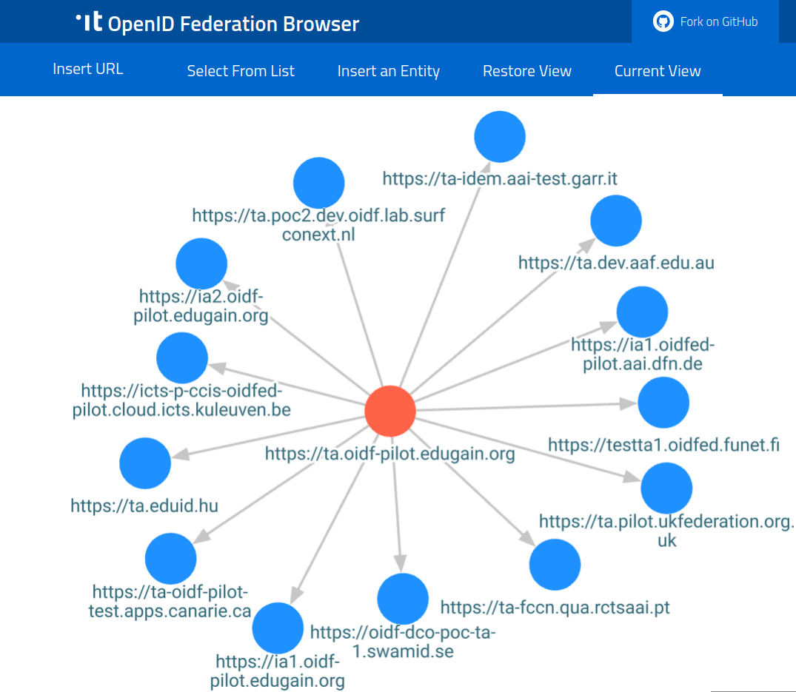
eduGAIN OIDF Pilot intermediate results
https://italia.github.io/openid-federation-browser/main/
Notes:
Hierarchical model where the eduGAIN interfederation can build upon
national federation for onboarding entities, eduGAIN is a Trust Mark Issuer. The trust marks is a key capability of the OpenID Federation protocol which allows eduGAIN to “pixy dust” entities onboarded in national federation with additional trust so they can be part of the interfaderation

Slide 8
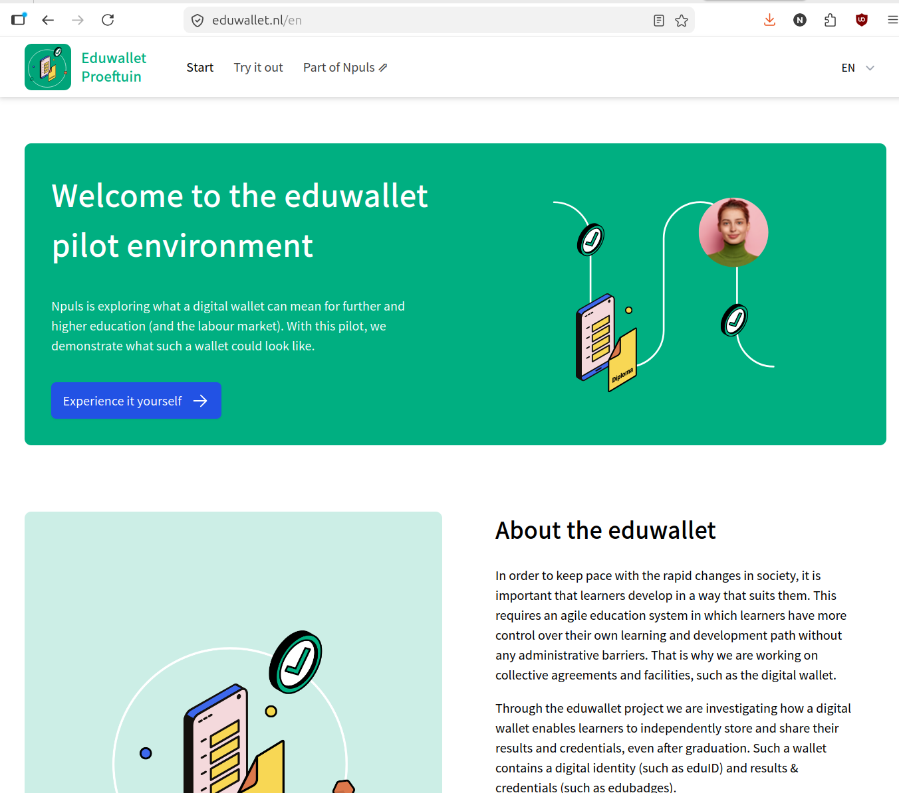
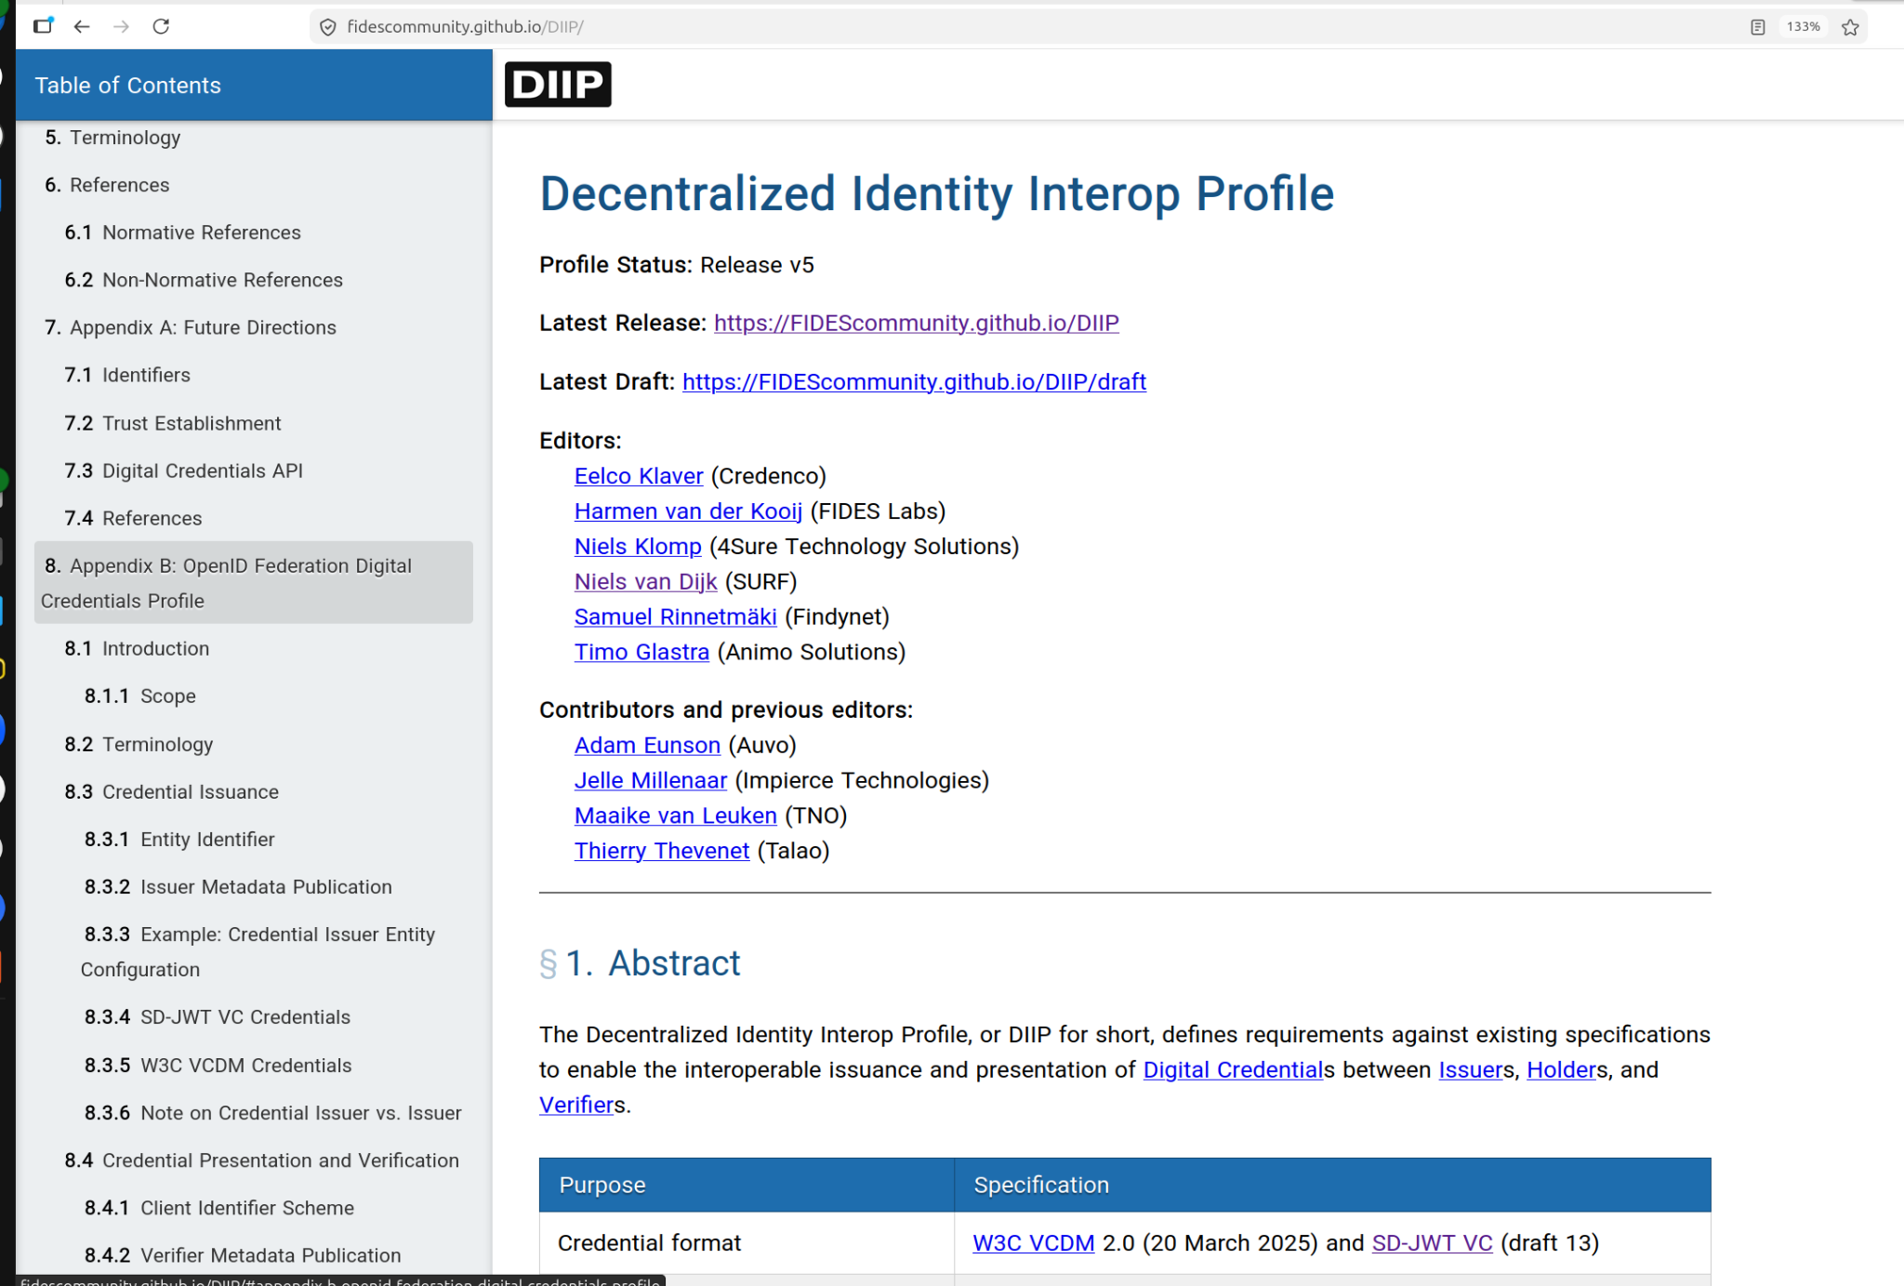
OpenID Federation & Wallets
https://fidescommunity.github.io/DIIP/
https://openid.net/specs/openid-federation-wallet-1_0.html
https://eduwallet.nl/en
TUE 21 15.55 B 09 - “EUDI Wallets in Practice: Early Adoption & Lessons Learned II“

Slide 9
Thank You

